Slide 1

6th Grade Math
Unit 12, Lesson 1 Finding an Unknown Decimal in an Equation Volume 2, pg. 281

Slide 2


Benchmark
MA.6.AR.2.4
Determine the unknown decimal or fraction in an equation involving any of the four operations, relating three numbers, with the unknown in any position.
volume 2, pg. 281

Slide 3
Integrated Mathematical Thinking and Reasoning Standards
MA.K12.MTR.1.1 Actively participate in effortful learning both individually and collectively.
MA.K12.MTR.2.1 Demonstrate understanding by representing problems in multiple ways.
MA.K12.MTR.4.1 Engage in discussions that reflect on the mathematical thinking of self and others.
MA.K12.MTR.5.1 Use patterns and structure to help understand and connect mathematical concepts.
volume 2, pg. 281

Slide 4

Learning Target
I can determine an unknown decimal in a numeric equation with three numbers.
volume 2, pg. 281

Slide 5

Warm-Up
volume 2, pg. 281

Slide 6
12.1.1 Warm-Up: What Is STEM?
Science, Technology, Engineering, and Mathematics (STEM) is a way of thinking and doing. STEM skills are useful to almost every career.
An individual does not need to be a master in all four areas of STEM to be successful; teamwork plays an important role. Playing to a person’s strengths and working as a team creates a greater impact than working alone.
volume 2, pg. 281

Slide 7
Describe a time where it was better for you to work as a team than alone.
List two jobs that involve working as a team but are in different fields of STEM.
volume 2, pg. 281

Slide 8

Refresher
volume 2, pg. 282

Slide 9

12.1.2 Refresher: The Unknown Value
With your partner, complete the following.
In math, variables are used to represent unknown values.
In an algebraic expression, a variable is a letter that represents a number.
Circle the variable(s) in each expression.
$$m+5$$ | $$2x+y$$ | $$\frac{a}{4}$$
volume 2, pg. 282

Slide 10

Variables are found in algebraic equations.
An equation is a mathematical relation statement where two equivalent expressions or values are separated by an equal sign.
An algebraic equation is an equation with at least one variable.
volume 2, pg. 282

Slide 11

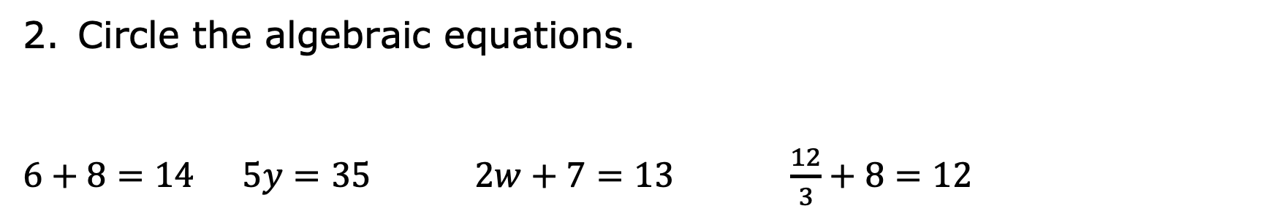
Circle the algebraic equations.
$6+8=14$ $5y=35$ $2w+7=13$ $\frac{12}{3}+8=12$
To solve an equation means to find the solution.
The solution(s) to an algebraic equation is (are) the value(s) of the variable(s) that makes the equation true.
volume 2, pg. 282

Slide 12

Guided Instruction
volume 2, pg. 282

Slide 13

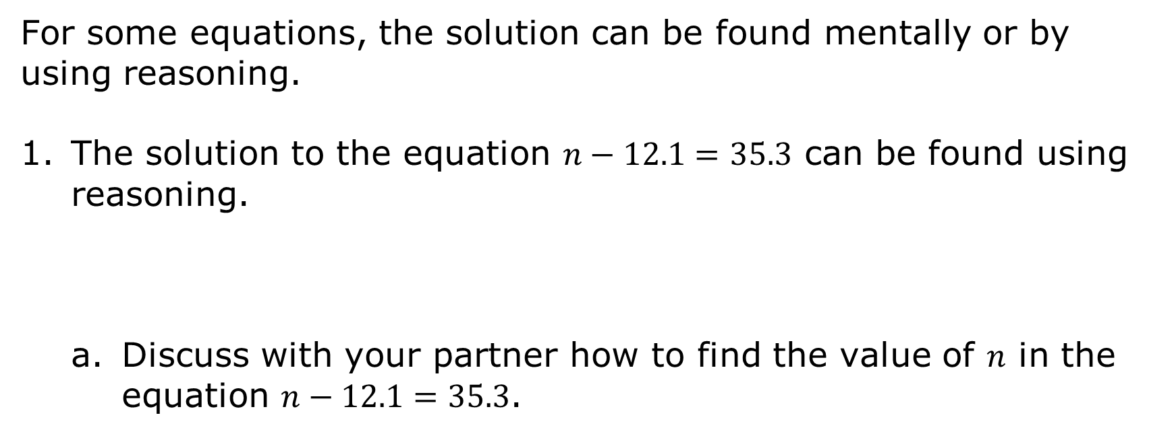
12.1.3 Guided Instruction: Solving Equations Using Reasoning and Diagrams
For some equations, the solution can be found mentally or by using reasoning.
The solution to the equation $n−12.1=35.3$ can be found using reasoning.
Discuss with your partner how to find the value of 𝑛 in the equation $n−12.1=35.3$.
volume 2, pg. 282

Slide 14
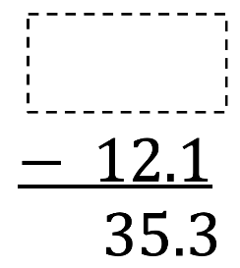
The equation is rewritten vertically with a box in the place of the variable. Write the solution in the box and check whether it makes the equation true.
volume 2, pg. 282

Slide 15
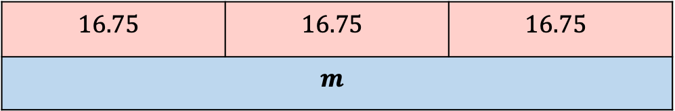
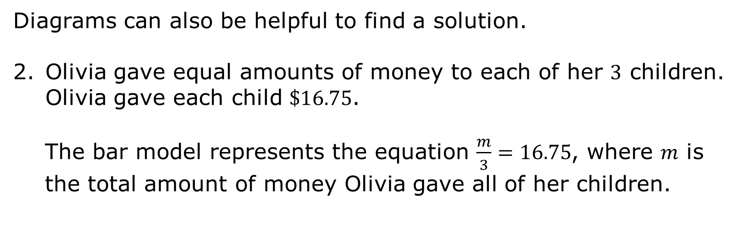
Diagrams can also be helpful to find a solution.
Olivia gave equal amounts of money to each of her $3$ children. Olivia gave each child $\$16.75$.
The bar model represents the equation $\frac{m}{3}=16.75$, where 𝑚 is the total amount of money Olivia gave all of her children.
$$16.75$$ | $$16.75$$ | $$16.75$$
$$m$$
volume 2, pg. 283

Slide 16
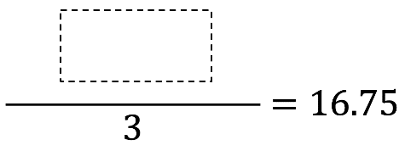
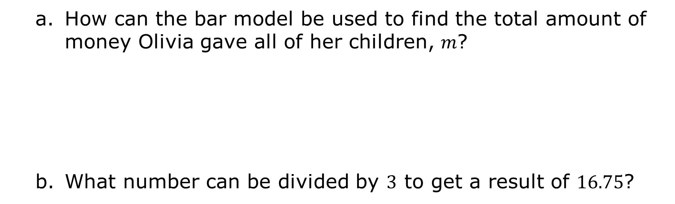
How can the bar model be used to find the total amount of money Olivia gave all of her children, 𝑚?
What number can be divided by $3$ to get a result of $16.75$?
volume 2, pg. 283

Slide 17
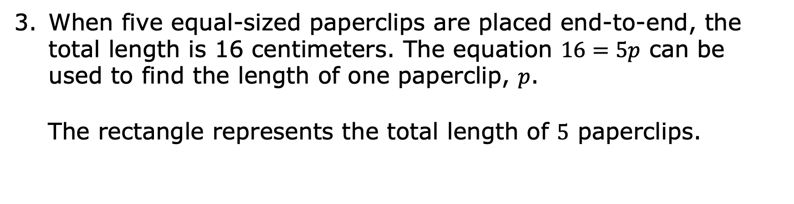
When five equal-sized paperclips are placed end-to-end, the total length is 16 centimeters. The equation $16=5p$ can be used to find the length of one paperclip, 𝑝.
The rectangle represents the total length of $5$ paperclips.
volume 2, pg. 283

Slide 18

How can the picture be used to find the value of 𝑝 in the equation $16=5p$?
What number can be multiplied by $5$ to result in $16$?
$$16=5\left( \right)$$
What is the length of each paperclip?
volume 2, pg. 283

Slide 19

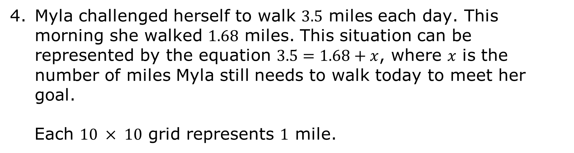
Myla challenged herself to walk $3.5$ miles each day. This morning she walked $1.68$ miles. This situation can be represented by the equation $3.5=1.68+x$, where 𝑥 is the number of miles Myla still needs to walk today to meet her goal.
Each $10 × 10$ grid represents $1$ mile.
volume 2, pg. 284

Slide 20
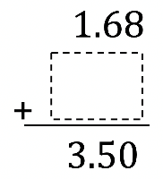

Discuss with your partner how to use the $10 × 10$ grids to represent the equation $3.5=1.68+x$.
What number can be added to $1.68$ to get $3.5$?
Check your solution.
volume 2, pg. 284

Slide 21

Collaboration
volume 2, pg. 284

Slide 22

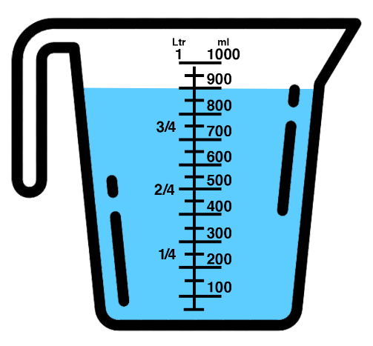
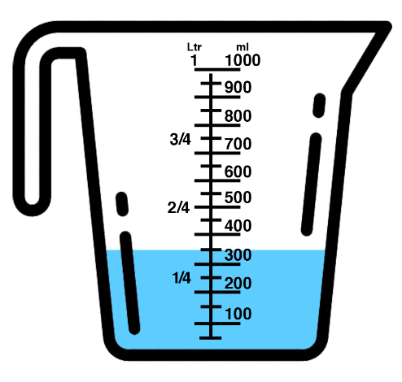
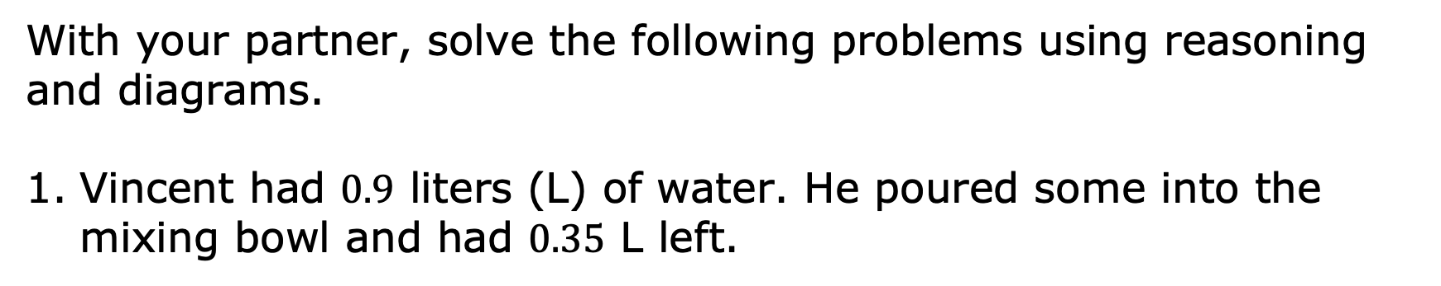
12.1.4 Collaboration: Solving Equations Using Reasoning & Diagrams
With your partner, solve the following problems using reasoning and diagrams.
Vincent had $0.9$ liters (L) of water. He poured some into the mixing bowl and had $0.35$ L left.
volume 2, pg. 284

Slide 23
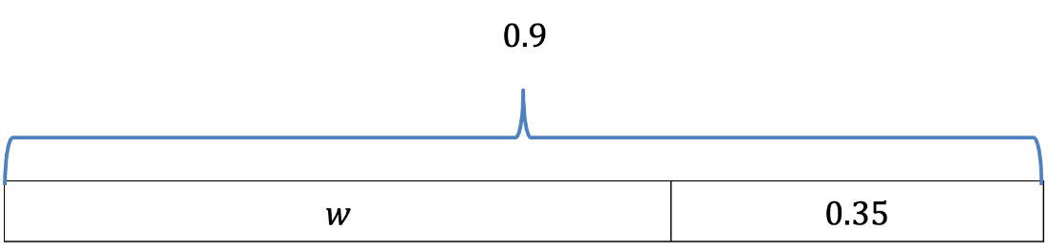
The bar model shown represents this situation.
Discuss with your partner how the bar model represents Vincent’s situation. Then, write a brief summary of your discussion.
volume 2, pg. 284

Slide 24
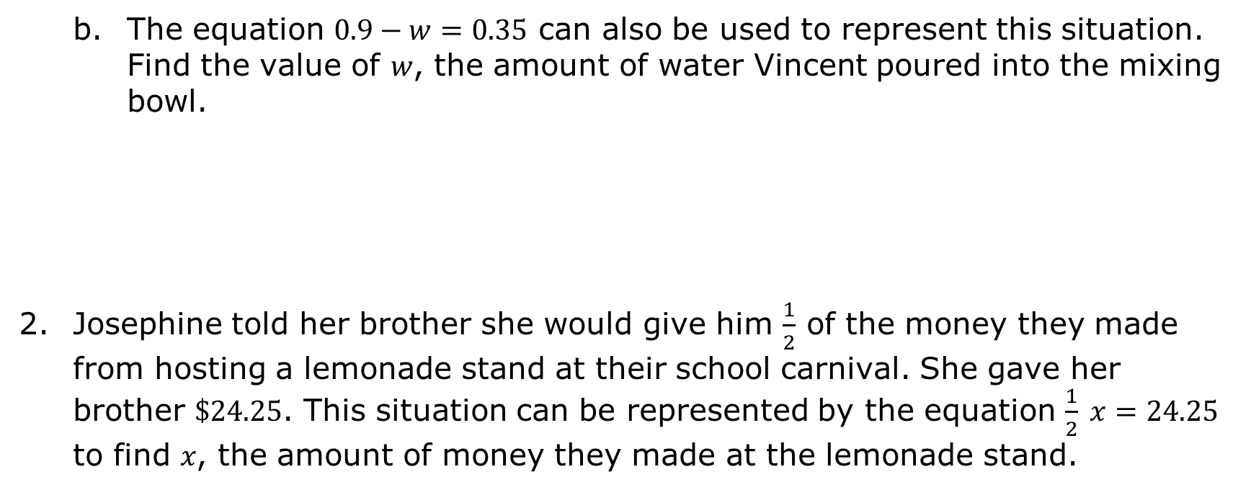
The equation $0.9−w=0.35$ can also be used to represent this situation. Find the value of 𝑤, the amount of water Vincent poured into the mixing bowl.
Josephine told her brother she would give him $\frac{1}{2}$ of the money they made from hosting a lemonade stand at their school carnival. She gave her brother $\$24.25$. This situation can be represented by the equation $\frac{1}{2} x=24.25$ to find 𝑥, the amount of money they made at the lemonade stand.
volume 2, pg. 285

Slide 25
Use the bar model shown to represent the situation.
Find the value of 𝑥, the amount of money they made at the lemonade stand.
volume 2, pg. 285

Slide 26

Your Turn
volume 2, pg. 285

Slide 27

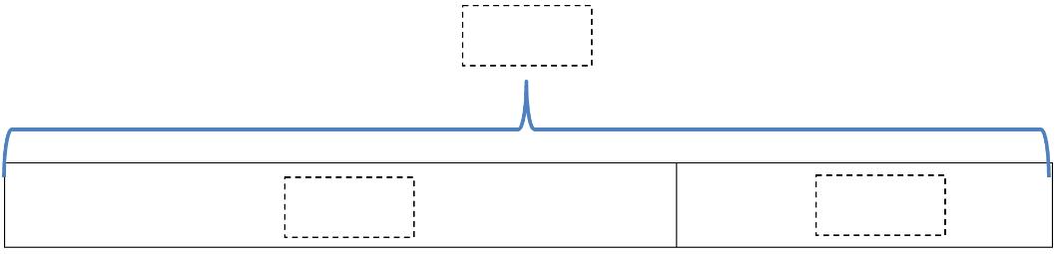
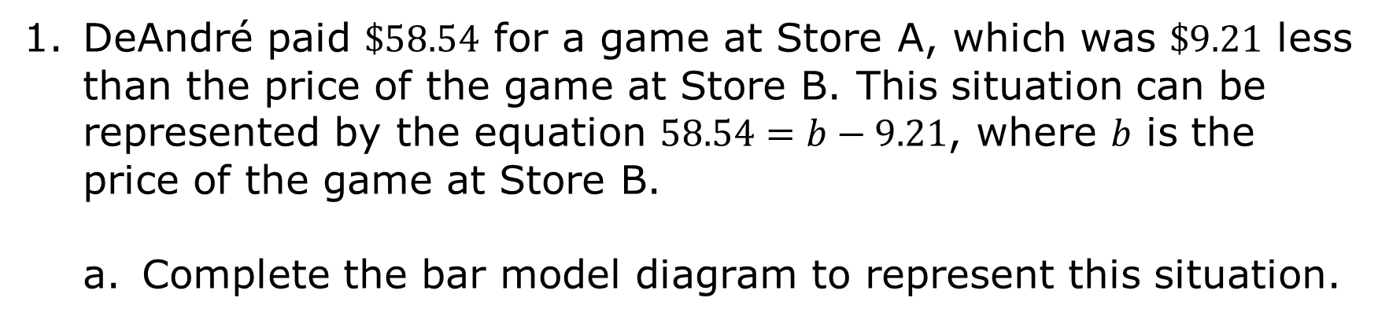
12.1.5 Your Turn!
DeAndré paid $\$58.54$ for a game at Store A, which was $\$9.21$ less than the price of the game at Store B. This situation can be represented by the equation $58.54=b−9.21$, where 𝑏 is the price of the game at Store B.
Complete the bar model diagram to represent this situation.
volume 2, pg. 285

Slide 28
Find the value of 𝑏.
volume 2, pg. 285

Slide 29
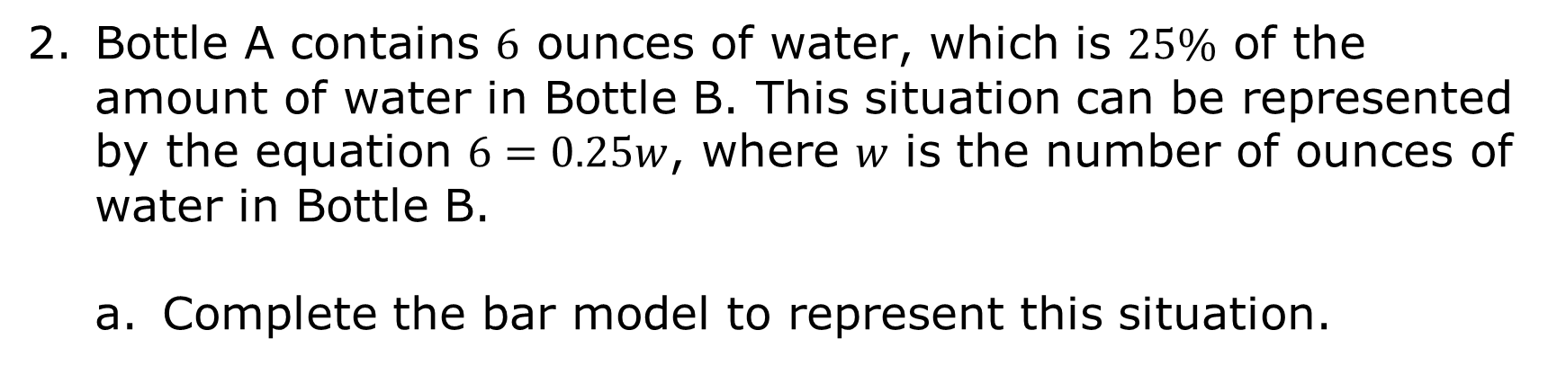
Bottle A contains $6$ ounces of water, which is $25\%$ of the amount of water in Bottle B. This situation can be represented by the equation $6=0.25w$, where 𝑤 is the number of ounces of water in Bottle B.
Complete the bar model to represent this situation.
Bottle A
Bottle B
volume 2, pg. 286

Slide 30
Find the value of 𝑤.
volume 2, pg. 286

Slide 31

Wrap-Up
volume 2, pg. 286

Slide 32
12.1.6 Wrap-Up: Reflection
Complete the learning pyramid.
One question I would like to have answered …
One mistake I learned from today …
One thing I am not sure about … YET!
One thing I am confident I know is …
volume 2, pg. 286

